Slide 1
Credit Card Fraud Detection
By: Alex Lux

Slide 2
Problem Statement / Motivation Behind Topic
Worldwide credit card fraud has risen each year for the past decade. In 2016, losses topped $24 billion dollars.
In the United States, credit card fraud was the most common form of identity theft in four of the last five years.
The U.S. is the country with the most fraud and makes up more than a third of global card fraud losses.
Instances of identity theft by credit card fraud increased by 44.6% from 271,927 in 2019 to 393,207 in 2020.

Slide 3
Task Defenition
The task is to recognize fraudulent credit card transactions so that the customers of credit card companies are not charged for items that they did not purchase.
Main challenges involved in credit card fraud detection are:
Enormous Data is processed every day and the model build must be fast enough to respond to the scam in time.
Imbalanced Data, most of the transactions (99.8%) are not fraudulent which makes it really hard for detecting the fraudulent ones
Data availability as the data is mostly private.
Misclassified Data can be another major issue, as not every fraudulent transaction is caught and reported.
Adaptive techniques used against the model by the scammers.

Slide 4
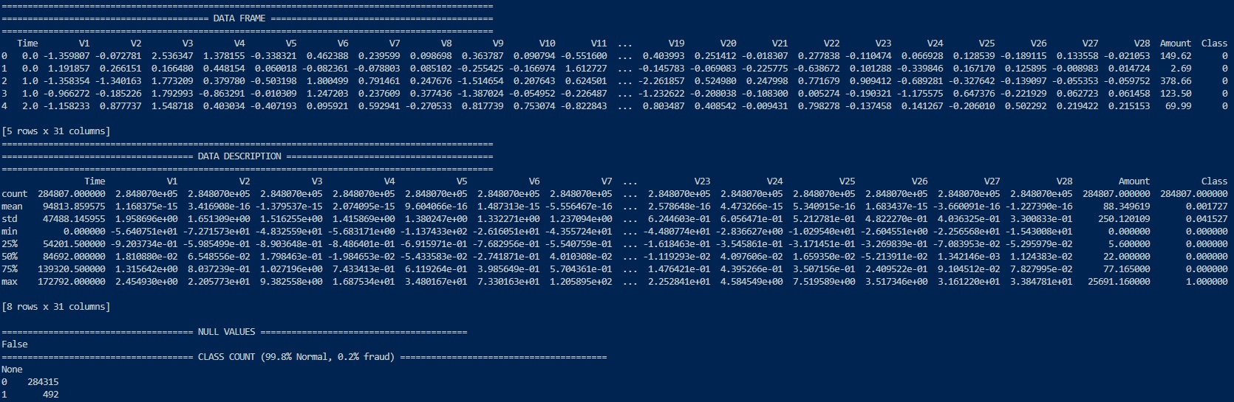
The Dataset
Do to confidentiality issues, the original features and more background information about the data can not be provided. Features V1, V2, … V28 are the principal components obtained with PCA, the only features which have not been transformed with PCA are 'Time' and 'Amount'.
https://www.kaggle.com/datasets/mlg-ulb/creditcardfraud

Slide 5
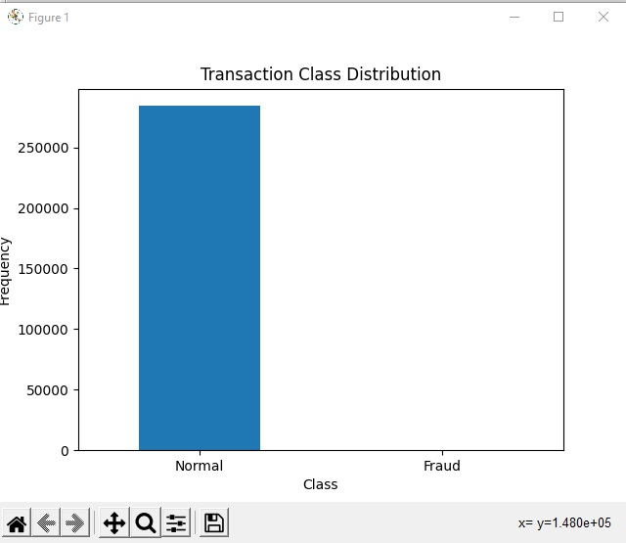
https://www.kaggle.com/datasets/mlg-ulb/creditcardfraud

Slide 6

Preprocessing / Data Cleanup
As this dataset does not contain any missing/null values or categorical data, data pre-processing steps are not needed.
The two steps I took before training my models:
Taking a sample of the data set because there are
2 train test splits

Slide 7
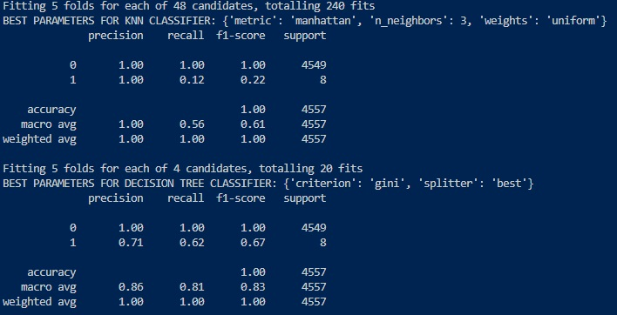
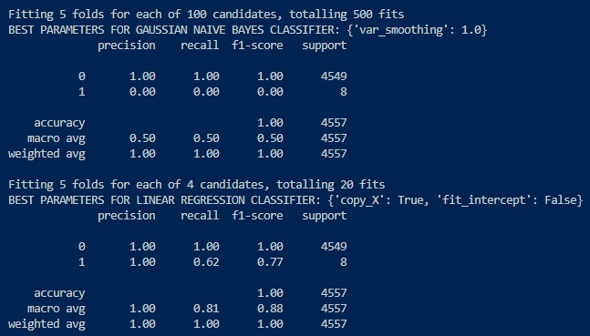
Models

Slide 8
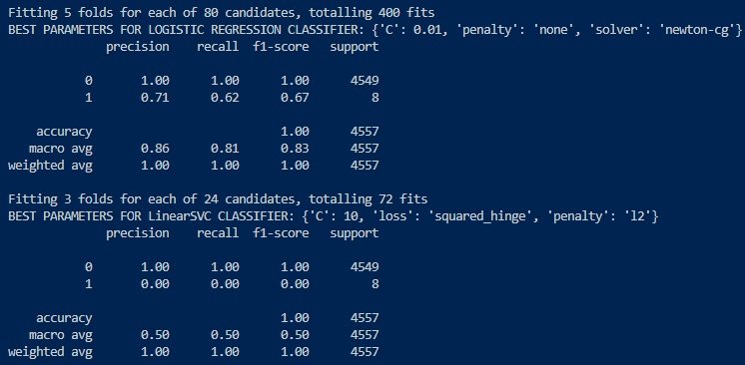
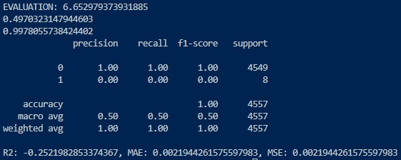
Models

Slide 9
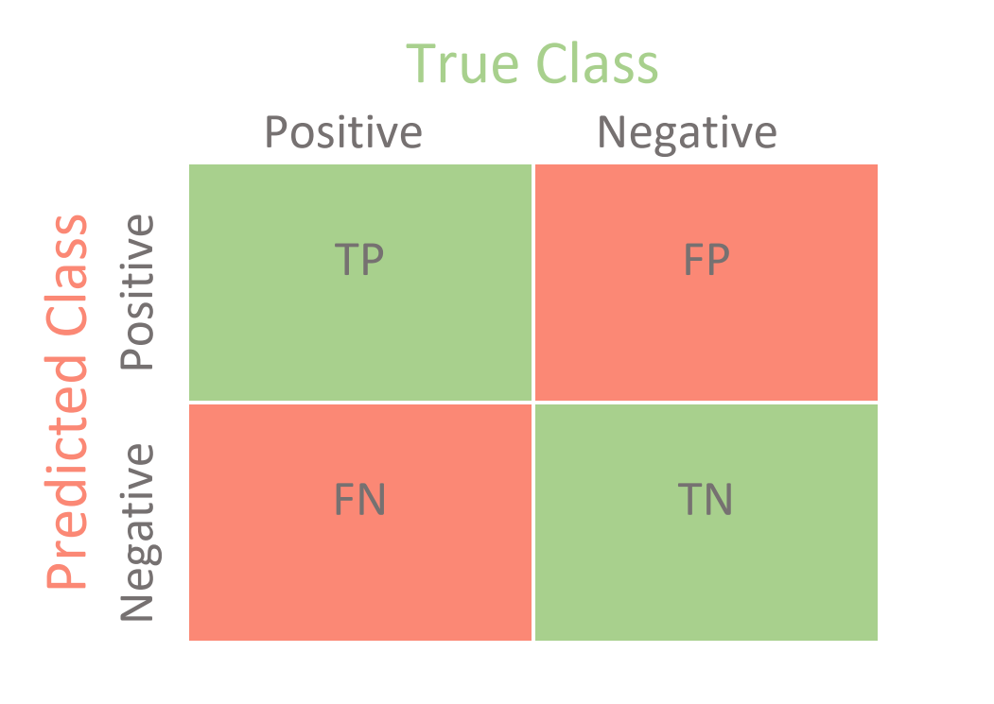






Model Results
Most of the models maintain a high classification accuracy but it does nothing to solve the problem. Having a model that simply predicts 0 for every example will return 99.83% accuracy which is typically excellent for a binary classification predictor but not in this case. To account for this I evaluated precision (TP / (TP + FP)) instead. False positives are very harmful because they prevent customers from using their credit cards.
Valid
Fraud
Valid
Fraud
Decision Tree
Logistic Regression
Neural Network
KNN
Gaussian
Linear SVC

Slide 10
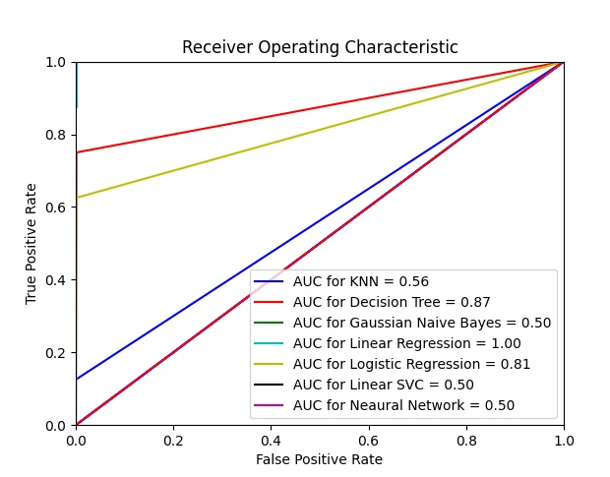
Conclusion
The best model for detecting credit card fraud is the decision tree classifier based on ROC curve results. As shown below the ROC curve is created by plotting the true positive rate against the false positive rate at various threshold settings. The optimal threshold value is the one for the point closest to (0, 1).
A receiver operating characteristic curve, or ROC curve, is a graphical plot that illustrates the diagnostic ability of a binary classifier system as its discrimination threshold is varied.

Slide 11
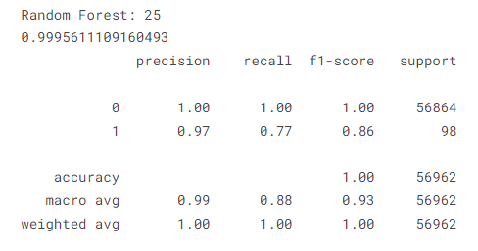
Improvements
From sources online a Random Forest classifier is the most optimal model for this task. The model can yield an accuracy of 99.9% and a precision of 97.4%.

Slide 12
Link to the Code
https://github.com/alexlux58/Machine-Learning-Project

